Slide 1
“Araby”: James Joyce’s Dublin
Week Two: Analyzing Short Stories

Slide 2
Agenda
1. Discuss the geography of the story and the reality of Dublin in the early 20th century
2. Joyce’s religious and literary allusions in “Araby”
3. Questions from Discussion Board and details on how to write triple-entry notebooks

Slide 3
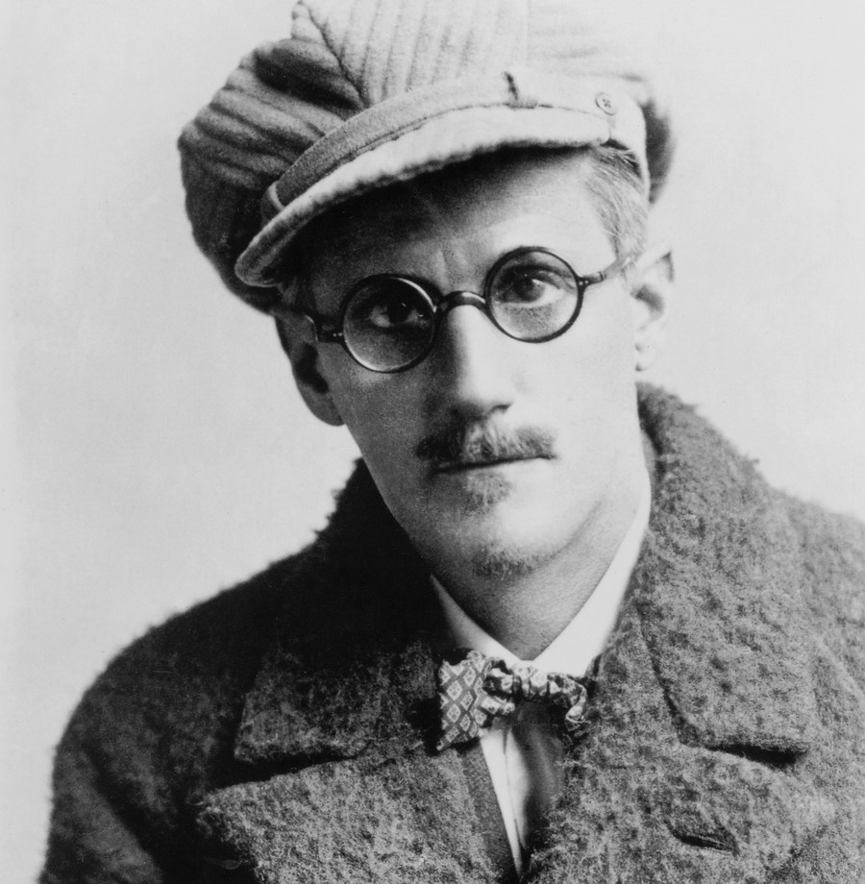
James Joyce 1882-1941
Most famous work both for its controversial themes, dirty and low-brow language, and beautiful and incredibly complicated prose: Ulysses which is a novel all set in one day that follows the myth of Odysseus
Dubliners was his first major work

Slide 4



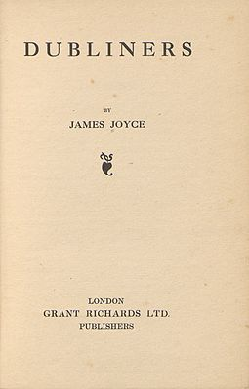
Dubliners
Collection of 15 stories
Published in 1914 but many stories were written in 1904
Difficult publication history due to controversial material

Slide 5
Funny Quote about Joyce’s Perfectionism
“I've been working hard on [Ulysses] all day," said Joyce. Does that mean that you have written a great deal?" I said. Two sentences," said Joyce. I looked sideways but Joyce was not smiling. I thought of [French novelist Gustave] Flaubert. "You've been seeking the mot juste?" I said. No," said Joyce. "I have the words already. What I am seeking is the perfect order of words in the sentence.”

Slide 6
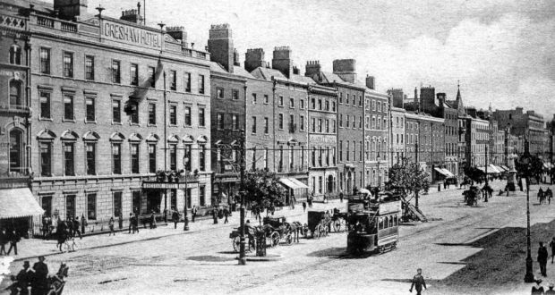
Joyce’s Dublin

Slide 7
Mapping out the Narrator’s Story
“North Richmond Street, being blind, was a quiet street except at the hour when the Christian Brothers’ School set the boys free. An uninhabited house of two storeys stood at the blind end, detached from its neighbours in a square ground. The other houses of the street, conscious of decent lives within them, gazed at one another with brown imperturbable faces” (11).

Slide 8
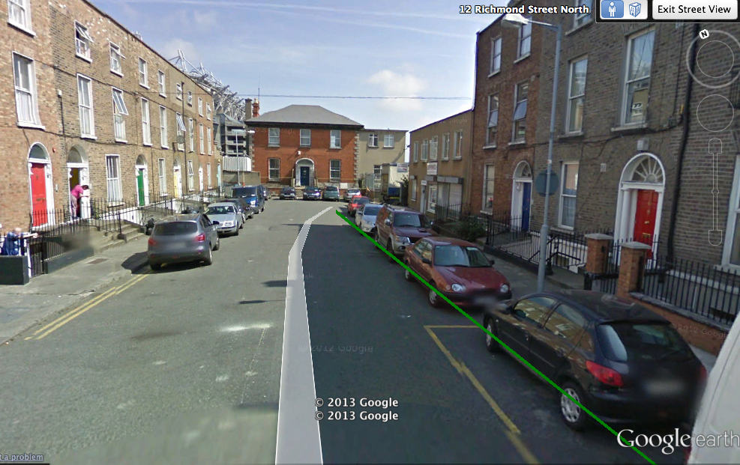
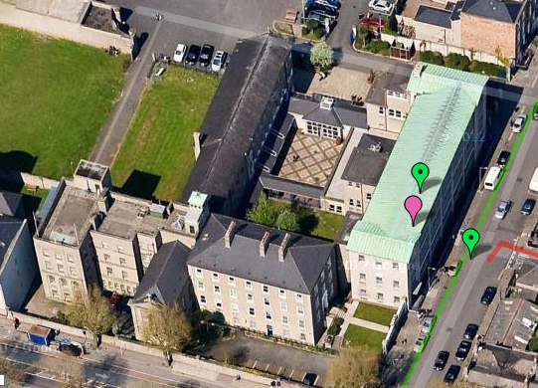
Realism of the Locations
North Richmond St. in 2013
O’Connell Christian Brothers’ School, 2013

Slide 9
The Historical 1894 Araby Bazaar
The bazaar opened on Monday 14 May (though the official opening by the Lord Lieutenant, Lord Houghton, only took place on Tuesday 15 May) and ran until Saturday 19 May 1894. It was held in aid of Jervis Street Hospital, an institution run by the Catholic Sisters of Mercy.
The programme for the Araby bazaar promised a ‘Grand Oriental Fete’ and was illustrated with images of an Arab mounted on a camel and oriental-looking buildings with onion domes and minarets. Admission to the bazaar was one shilling. The bazaar had its own theme song, with words by WG Wills and music by Frederick Clay, the first verse of which went:
I’ll sing to thee of Araby, And tales of fair Cashmere, Wild tales to cheat thee of a sigh, Or charm thee to a tear.
To add to the oriental atmosphere the catalogue promised a ‘magnificent representation of an oriental city,’ complete with Cairo donkeys and donkey boys, and an Arab encampment. Entertainment would include an international tug-of-war, dances by 250 trained children, eastern magic from the Egyptian Hall in London, ‘skirt dancing up to date,’ a grand theatre of varieties, tableaux, theatricals, and Christy Minstrels.
Other diversions included switchback railways and roundabouts, ‘Menotti, the King of the air,’ the great Stockholm wonder, bicycle polo, rifle and clay pigeon shooting, and magnificent displays of fireworks by Brock, of the Crystal Palace, London.

Slide 10
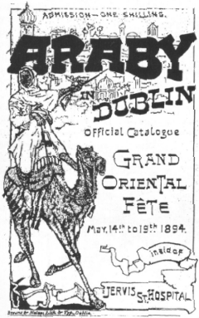

Slide 11
The “Real” 1894 Araby versus the Story’s Representation of Araby
Narrator’s Araby
1894 Araby
I could not find any sixpenny entrance and, fearing that the bazaar would be closed, I passed in quickly through a turnstile, handing a shilling to a weary-looking man. I found myself in a big hall girdled at half its height by a gallery. Nearly all the stalls were closed and the greater part of the hall was in darkness.
The Araby Bazaar was, in reality, one of the largest public spectacles held in Dublin in the late nineteenth century.At least 92,000 visitors attended and one could deduce that a high percentage were Catholic
The prices Joyce quotes are, in fact, accurate.
The admission-price for Araby, like the other bazaars, was two shillings for the day of the opening ceremony and one shilling per day thereafter, with a season ticket for the week costing four shillings. Children under twelve were admitted for half-price. At most of the bazaars, certain entertainments cost extra. At Araby, entrance to the Paddock where the firework displays took place was sixpence extra, with seats in the Grand Stand costing either sixpence or one shilling each.

Slide 12
Historical versus Fictional Araby
Narrator’s Araby
1894 Araby
At the door of the stall a young lady was talking and laughing with two young gentlemen. I remarked their English accents and listened vaguely to their conversation.
“O, I never said such a thing!”
“O, but you did!”
“O, but I didn’t!”
“Didn’t she say that?”
“Yes. I heard her.”
“O, there’s a ... fib!”
In Joyce's 'Araby', the bazaar-girls and their customers whose conversation the narrator overhears are described as having 'English accents' ('Araby', 25.193-4). In reality, however, the volunteers at the Araby Bazaar were Irish. This is either another example of Joyce's creative adaptation of the real bazaar, or is possibly intended as an indication that these upper-middle-class Irish voices sounded English to the lower-middle-class narrator's inexperienced ear.

Slide 13
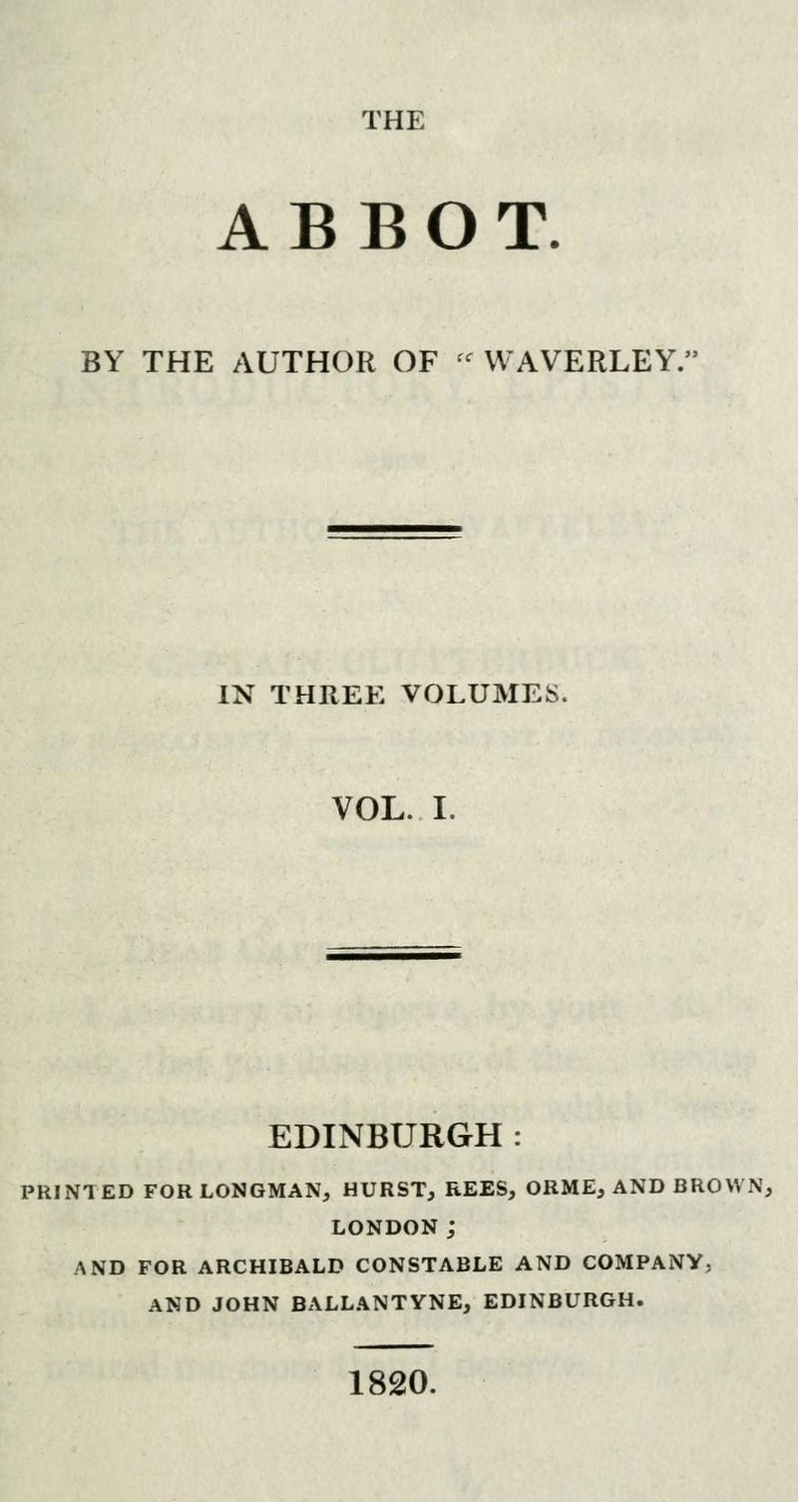
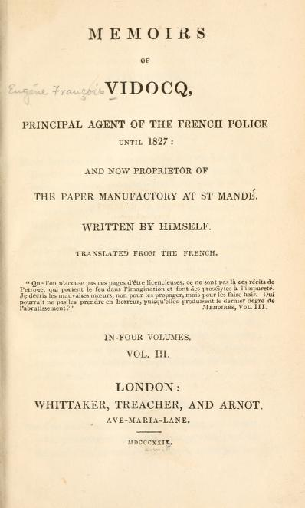
Allusions to Romantic and Gothic Literature “Among these I found a few paper-covered books, the pages of which were curled and damp: The Abbot, by Walter Scott, The Devout Communicant and The Memoirs of Vidocq. I liked the last best because its leaves were yellow.”
The Abbot, by Sir Walter Scott is a 19th century historical novel which idealizes Mary, Queen of Scotts (a Catholic) who was executed by Queen Elizabeth in 1567
The Devout Communicant is a piece of Catholic devotional literature could have referred to any of several works, but certainly includes pious language and religious icons
The Memoirs of Vidocq was a popular account of a criminal named Vidocq (1775-1857) turned detective and translated from the French into English by and Irishman

Slide 14
Why is she called “Mangan’s sister”
Joyce’s Mangan
The narrator’s Mangan’s sister
James Clarence Mangan (1803-1849) was an Irish romantic poet and one of Joyce’s favorites
Joyce presented a paper on Mangan in February of 1902, which was later published in the student literary magazine
Most interesting, the poet Mangan often wrote poems in which he pretended were translations from the Arabic (although Mangan did not know what language
Or if Mangan’s sister came out on the doorstep to call her brother in to his tea we watched her from our shadow peer up and down the street. We waited to see whether she would remain or go in and, if she remained, we left our shadow and walked up to Mangan’s steps resignedly. She was waiting for us, her figure defined by the light from the half-opened door. Her brother always teased her before he obeyed and I stood by the railings looking at her. Her dress swung as she moved her body and the soft rope of her hair tossed from side to side.

Slide 15
Close-reading “Mangan’s sister”
Every morning I lay on the floor in the front parlour watching her door. The blind was pulled down to within an inch of the sash so that I could not be seen. When she came out on the doorstep my heart leaped. I ran to the hall, seized my books and followed her. I kept her brown figure always in my eye and, when we came near the point at which our ways diverged, I quickened my pace and passed her. This happened morning after morning. I had never spoken to her, except for a few casual words, and yet her name was like a summons to all my foolish blood.
Her image accompanied me even in places the most hostile to romance. On Saturday evenings when my aunt went marketing I had to go to carry some of the parcels. We walked through the flaring streets, jostled by drunken men and bargaining women, amid the curses of labourers, the shrill litanies of shop-boys who stood on guard by the barrels of pigs’ cheeks, the nasal chanting of street-singers, who sang a come-all-you about O’Donovan Rossa, or a ballad about the troubles in our native land. These noises converged in a single sensation of life for me: I imagined that I bore my chalice safely through a throng of foes. Her name sprang to my lips at moments in strange prayers and praises which I myself did not understand. My eyes were often full of tears (I could not tell why) and at times a flood from my heart seemed to pour itself out into my bosom. I thought little of the future. I did not know whether I would ever speak to her or not or, if I spoke to her, how I could tell her of my confused adoration. But my body was like a harp and her words and gestures were like fingers running upon the wires.

Slide 16
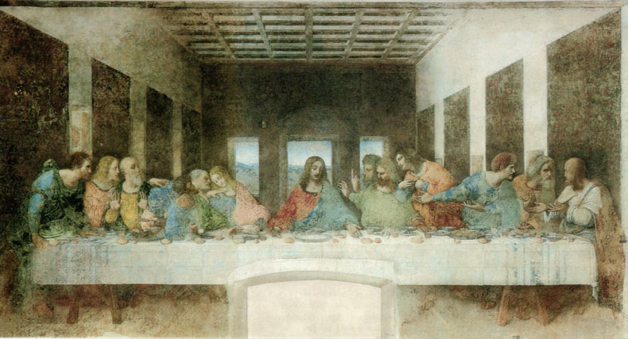
The Holy Grail and other Catholic Iconography “I imagined that I bore my chalice safely through a throng of foes.”

Slide 17
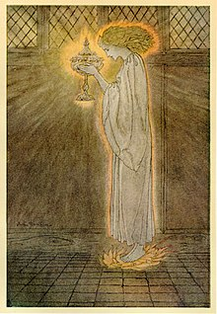
The Holy Grail The Holy Grail is a vessel that serves as an important motif in Arthurian literature. Different traditions describe it as a cup, dish or stone with miraculous powers that provide happiness, eternal youth or sustenance in infinite abundance. The term "holy grail" is often used to denote an object or goal that is sought after for its great significance.
Distinctly, the word grail, as it was known in its earliest spelling, indicates an Old French word of “graal” or “greal” along with Old Provencal “grazal,” and Old Catalan “gresel,” which all roughly translate into the following definition: “a cup or bowl of earth, wood, or metal.” Additional words, such as the Latin “gradus” and the Greek “kratar” suggests that the vessel was one that was used during a meal at different stages or services, or was a winemaking bowl, lending the object to be associated with the Last Supper as well as the Crucifixion during medieval times and throughout legendary literature surrounding the Grail.

Slide 18
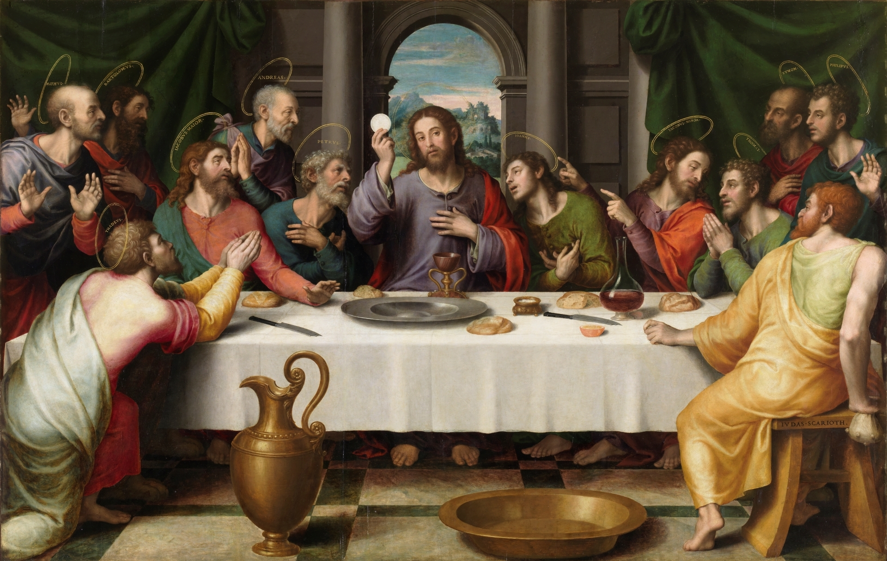

Slide 19
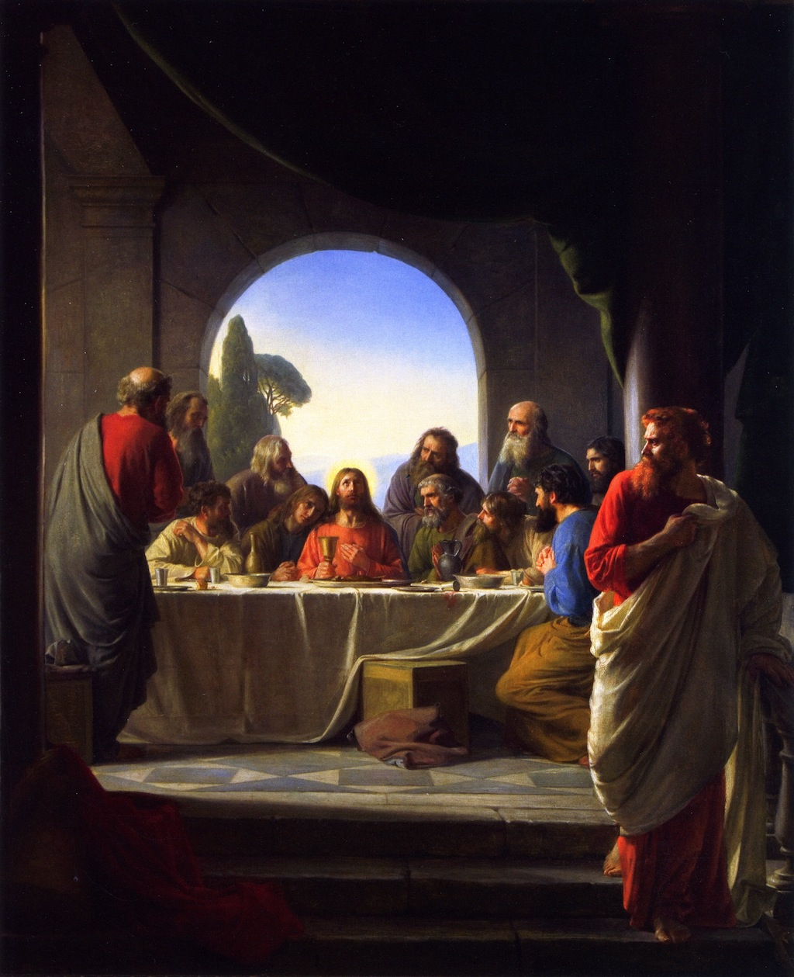
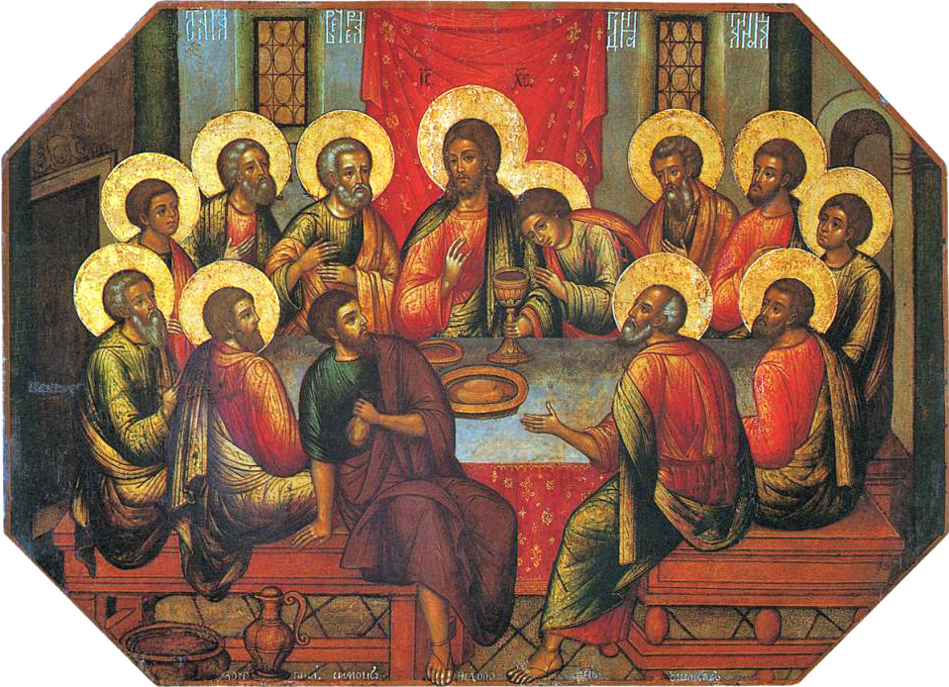

Slide 20
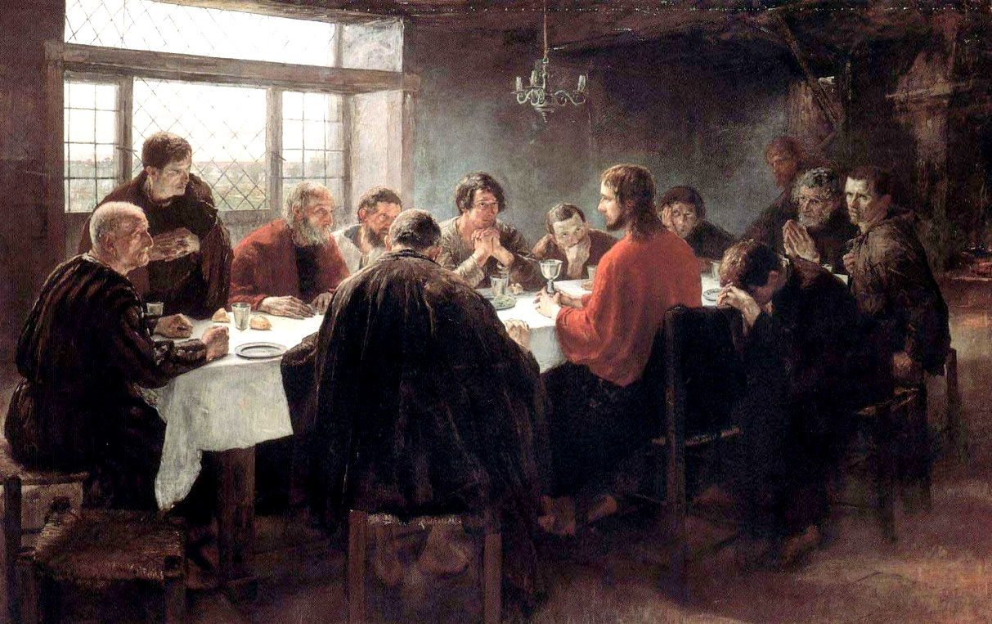

Slide 21
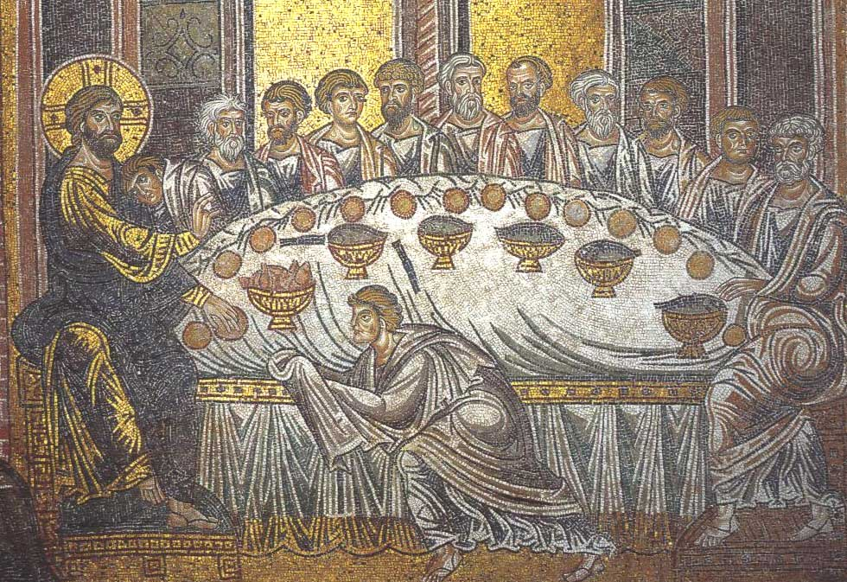
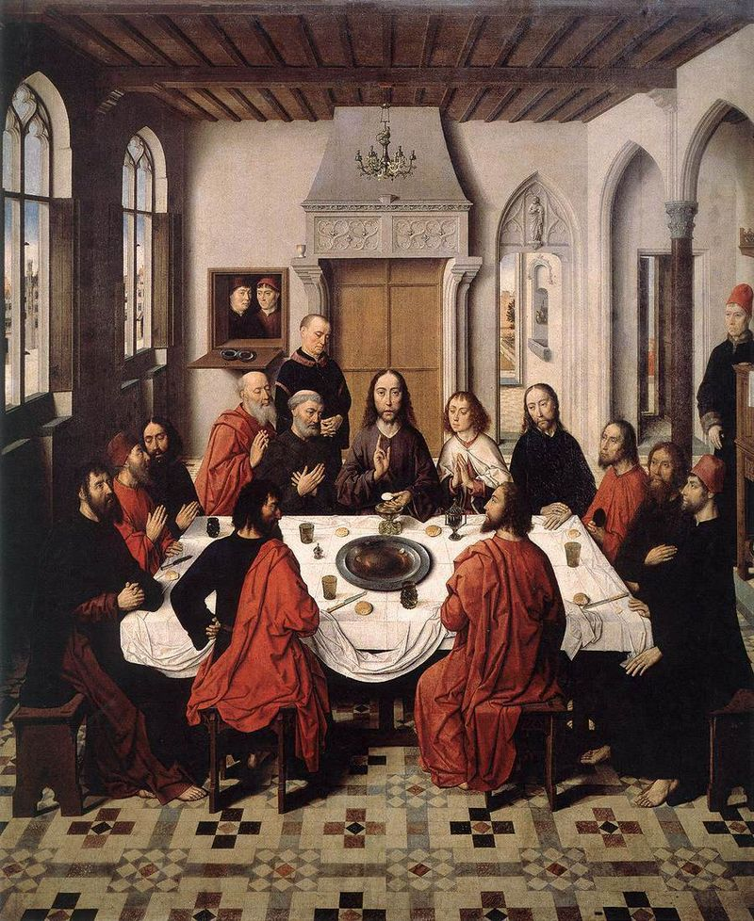

Slide 22
Holy Grail and the Narrator's Gift “If I go,” I said, “I will bring you something.”
While there is historical evidence for Jesus and the “last supper” he and his disciples had before the night of his crucifixion, the chalice they all drank from has not been discovered since and the “quest for the Holy Grail” is a legend that has been depicted in art, film, and literature
The mythology and legend of the “search for the Holy Grail”, however, has become an important part of British literature and helps us better understand our narrator
The narrator’s association between finding a present for Mangan’s sister and the Holy Grail must then be taken with even more interest when we consider how GRAND his quest seems to him.

Slide 23
And now your questions from the Discussion Board !

